Slide 1
Robotics CSC 2207
Dragule Swaib
Swaib.dragule@mak.ac.ug
0772285111

Slide 2

Robotics
Robotics is an interdisciplinary field that integrates engineering, computer science, and social considerations to create machine (robots), capable of performing tasks autonomously or semi-autonomously.

Slide 3
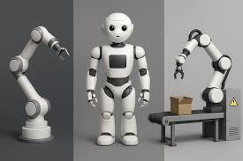
Robotics
Engineering perspective, it encompasses the design, construction, and actuation of physical systems, enabling robots to interact with the physical world.
Computer science perspective, it involves the development of software for perception (via sensors), cognition (planning, learning, and decision-making), and action (control systems), which together constitute the robot's intelligence.

Slide 4
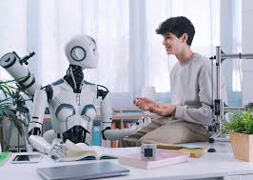
Robotics
Social and ethical perspective, robotics examines the design, deployment, and impact of robots within human environments.
This includes considerations of safety, collaboration, job displacement, ethical decision-making, privacy, and the broader societal effects of automating tasks in industries, healthcare, domestic life, and public spaces.

Slide 5
Robotics
Robotics is the practice of building intelligent, embodied agents that extend human capabilities, and the study of their responsible integration into society.
Robotics is the science and engineering of designing, building, and using robots.
A robot is a reprogrammable, multifunctional machine capable of performing tasks autonomously or semi-autonomously.
First coined by Karel Čapek in 1920 in the play R.U.R. (Rossum's Universal Robots).

Slide 6
Origin of the Term "Robot"
Derived from the Czech word robota, meaning “forced labor” or “worker.”
Early industrial robots were used for:
Handling dangerous materials (toxic, radioactive, hot)
Performing dull, dirty, or dangerous tasks (the “3 D’s”)
ISO definition: A machine with several degrees of freedom, often resembling an arm, capable of holding tools or workpieces.
A robot is an autonomous system which exists in the physical world, can sense its environment, and can act on it to achieve some goals.

Slide 7
Origin of the Term "Robot"
An autonomous robot acts on the basis of its own decisions, and is not controlled by a human.
They are said to be teleoperated; tele means “far” in Greek, so teleoperation means operating a system from afar.
A true robot exists in the physical world.
Sensing the environment means the robot has sensors, for perceiving (e.g., hearing, touching, seeing, smelling, etc.) in order to get information from the world
Taking actions to respond to sensory inputs and to achieve what is desired.
Robot to have one or more goals and to act so as to achieve those goals.
Robotics involves autonomy, sensing, action, and achieving goals, all in the physical world.

Slide 8
General Structure of a Robot Manipulator
A robot consists of five main components
Mechanical Structure, Rigid links connected by joints.
Actuators , Provide motion (electric, hydraulic, pneumatic).
Transmission Devices , Gears, linkages that transfer power.
Sensors , Provide feedback (position, velocity, force).
Control Unit ,
The “brain” that processes information and commands motion.

Slide 9
Multidisciplinary Nature of Robotics
Robotics integrates knowledge from
Mechanical Engineering – Structure, dynamics, materials
Electrical Engineering – Actuators, power systems
Computer Science – Control algorithms, AI, programming
Electronics – Sensors, embedded systems
Collaboration across disciplines is essential for successful robot design.

Slide 10
Introduction to Robotics Applications
Robots are no longer just in factories—they are everywhere:
Industrial – Manufacturing, assembly, welding
Service & Domestic – Cleaning, delivery, companionship
Medical – Surgery, rehabilitation, diagnostics
Exploration – Space, underwater, hazardous environments
Defense & Security – Surveillance, bomb disposal

Slide 11
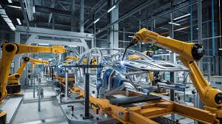
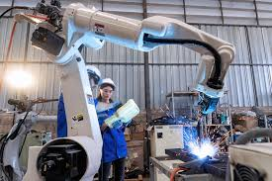
Industrial Robotics
Automotive Industry – Welding, painting, assembly
Electronics – PCB assembly, micro-soldering
Packaging & Palletizing – Fast, precise handling
Quality Inspection – Vision systems for defect detection
Advantages: Speed, precision, consistency, 24/7 operation

Slide 12
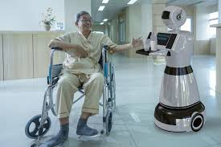
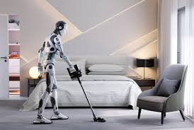
Service & Domestic Robotics
Vacuum Robots – e.g., Roomba
Social & Companion Robots – e.g., Pepper, Paro (therapeutic seal)
Delivery Robots – Food, medical supplies, parcels
Agricultural Robots – Harvesting, weeding, monitoring crops
Growing market due to AI and sensor advancements

Slide 13
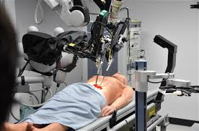
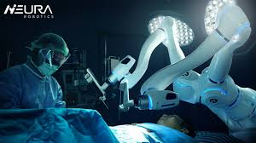
Medical Robotics
Surgical Robots – e.g., da Vinci System (minimally invasive)
Rehabilitation Robots – Assistive exoskeletons
Diagnostics & Lab Automation – Sample handling, testing
Telemedicine – Remote patient care and monitoring
Benefits: Precision, reduced recovery time, less human fatigue

Slide 14

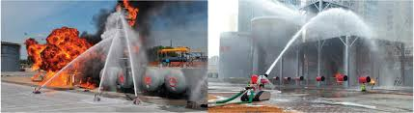
Exploration & Hazardous Environment Robots
Space Robotics – Mars rovers (Perseverance), robotic arms on ISS
Underwater Robotics – Pipeline inspection, deep-sea exploration
Disaster Response – Search and rescue in rubble, radiation zones
Nuclear & Chemical Handling – Reduce human exposure to hazards

Slide 15
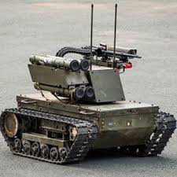
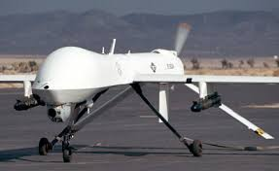
Military & Security Robotics
Unmanned Aerial Vehicles (UAVs) – Surveillance, reconnaissance
Bomb Disposal Robots – Safe handling of explosives
Autonomous Patrol Vehicles – Border surveillance
Ethical concerns – Autonomous weapon systems (lethal autonomous weapons)

Slide 16
Challenges in Robotics – Technical
Mobility & Dexterity
Navigating unstructured environments
Human-like manipulation still limited
Sensing & Perception
Real-time object recognition in varied conditions
Sensor fusion complexity
Power & Energy Efficiency
Batteries limit operational time
Heavy systems require high power

Slide 17
Challenges in Robotics – Intelligence & Autonomy
Decision-Making in Uncertain Environments
Human-Robot Interaction (HRI) – Natural communication, trust
Learning & Adaptation – Machines still lack common sense
Real-Time Processing – High computational demands

Slide 18
Challenges in Robotics – Safety & Reliability
Safe Human-Robot Collaboration – Avoiding injuries in shared spaces
Fail-Safe Mechanisms – Preventing malfunctions in critical tasks
Cybersecurity – Protecting robots from hacking
Long-Term Reliability – Wear and tear, maintenance costs

Slide 19
Ethical & Social Challenges
Job Displacement – Automation replacing human roles
Privacy – Surveillance capabilities of robots
Bias in AI – Reflecting human prejudices in decision-making
Accountability – Who is responsible when a robot causes harm?

Slide 20
Economic & Adoption Challenges
High Initial Cost – Expensive R&D and deployment
Integration with Existing Systems – Legacy infrastructure compatibility
Skill Gap – Need for trained roboticists and technicians
Regulation & Standards – Lack of universal safety and ethics guidelines

Slide 21
Case Study – Real-World Challenge
Example: Autonomous Vehicles
Technical Challenges: Sensor reliability, real-time decision-making
Ethical Challenges: “Trolley problem” – decision-making in accidents
Regulatory Challenges: Insurance, liability, and road laws
Social Acceptance: Public trust and adoption rate

Slide 22
Why Addressing Challenges Matters
Enables wider adoption in daily life
Promotes safe and ethical robot integration
Drives innovation in AI, materials, and energy
Ensures robots serve humanity positively

Slide 23
The Future of Robotics
Collaborative Robots (Cobots) – Working alongside humans
Soft Robotics – Flexible, adaptable structures
Swarm Robotics – Multiple robots working in coordination
AI-Powered Autonomy – Smarter, more adaptive systems
Bio-Inspired Robots – Mimicking nature for better design

Slide 24
Summary
Robots are everywhere: industry, home, medicine, exploration, defense
Challenges remain: technical, ethical, economic, and social
Progress requires collaboration: engineers, ethicists, policymakers, and society
The goal: Build robots that are capable, safe, and beneficial to all

Slide 25
The Evolving Landscape of Robotics
Ubiquitous Presence
Ethical Considerations
Social Integration
Future Vision
Robots are integrated into various sectors
Society grapples with the moral implications of robots
Robots need to be accepted and integrated into daily life
The goal is to create robots that benefit humanity
Robotics
Technical Hurdles
Economic Impact
Collaborative Progress
Engineers face challenges in robot design
Robots influence job markets and economic growth
Progress requires cooperation among stakeholders

Slide 26
Q&A / Discussion
What robot application excites you the most?
Which challenge do you think is the hardest to solve?
How can we ensure robots are developed ethically?

Slide 27
How to Classify a Robot
Robots can be grouped in multiple ways:
By Movement & Structure: How it is physically built and moves.
By Application & Sector: The job it is designed to do.
By Level of Autonomy: How independently it can operate and make decisions.
By Mobility: Whether it is fixed in place or can move around its environment.

Slide 28
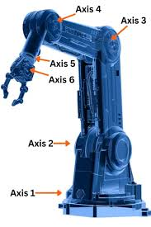
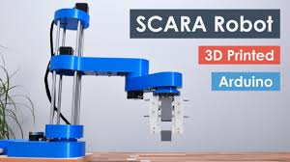
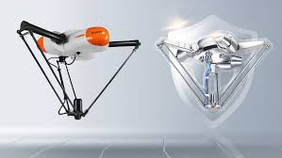
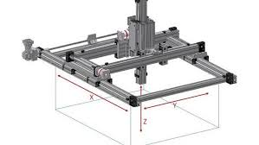
Classification by Physical Structure & Movement
Key categories of robotic manipulators
Articulated / 6-Axis: The most common industrial arm. Highly flexible with a rotating base and multiple joints. Example: Welding, painting.
SCARA: Fast and precise in a single horizontal plane. Example: Pick-and-place, assembly.
Cartesian / Gantry: Moves in straight lines along X, Y, Z axes. Very rigid and precise. Example: 3D printing, CNC machining.
Delta: Very high-speed parallel robot with "spider-like“ arms. Example: Food & pharmaceutical packaging.

Slide 29
Classification by Application & Sector
Where robots work defines their design:
Industrial: Manufacturing, assembly, welding, painting, palletizing.
Service & Commercial: Cleaning, delivery, hospitality, logistics (AMRs/AGVs).
Medical: Surgical assistance, rehabilitation, lab automation, patient care.
Consumer: Vacuum cleaners, lawn mowers, educational kits, companions.
Aerospace & Defense: Drones, space exploration rovers, bomb disposal.
Research & Exploration: Humanoids, ocean mapping, disaster response.

Slide 30
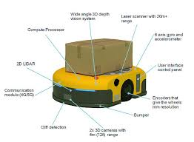
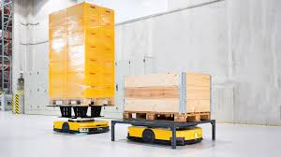
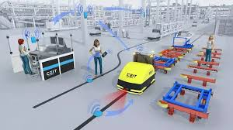
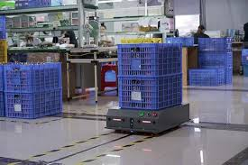
Key Robot Types in Detail (1)
Autonomous Mobile Robots (AMRs):
Use sensors and onboard intelligence to navigate and make real-time decisions in dynamic environments.
Examples: Hospital delivery bots, warehouse inventory robots.
Automated Guided Vehicles (AGVs):
Follow pre-defined paths (wires, magnetic tape) in structured environments. Less flexible than AMRs.
Examples: Material transport in factories.

Slide 31
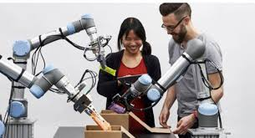
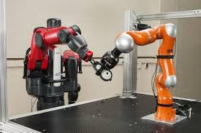
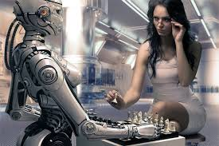
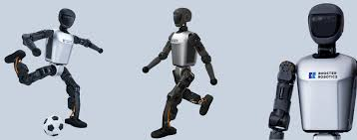
Key Robot Types in Detail (2)
Collaborative Robots (Cobots):
Designed with safety features (force sensing, rounded edges) to work alongside humans without cages.
Examples: Hand-guiding for assembly, machine tending.
Humanoid Robots:
Mimic the human form to operate in environments built for people.
A frontier of research for complex tasks and human-robot interaction.
Examples: Research platforms, public guidance, eldercare prototypes.

Slide 32
The State of the Art in Mobile Robotics
The frontier is no longer just movement—it’s intelligent perception and adaptation. Core Challenge: Robust Localization & Mapping Knowing "where am I?" in a complex, changing world is fundamental. The state of the art combines multiple advanced technologies to solve this.

Slide 33
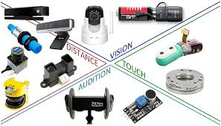
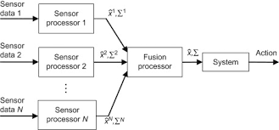
State of the Art: Technology Drivers (1)
Advanced Sensor Fusion:
Combining data from LiDAR, cameras, radar, and inertial sensors to create a robust, 3D understanding of the environment. Reduces the weakness of any single sensor.
AI & Machine Learning:
Deep Learning enables better object recognition, semantic understanding (e.g., "this is a door"), and prediction of how people or vehicles will move.
Allows for navigation in unstructured, novel environments without a pre-made map.

Slide 34
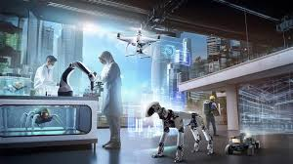
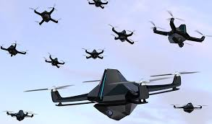
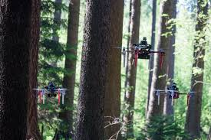
State of the Art: Technology Drivers (2)
Dynamic Environment Handling:
Algorithms that allow robots to operate reliably in crowded, unpredictable spaces (public streets, busy hospitals) where conditions change every second.
Cooperative Multi-Robot Systems:
Teams of robots that share maps and task data to work together efficiently.
Enables applications like swarm robotics for search & rescue or coordinated logistics.

Slide 35
The Intelligent Future
Classifying robots helps us understand their design purpose and capabilities.
The shift is toward greater autonomy, safety, and collaboration.
Mobile robotics is being revolutionized by perception, AI, and connectivity, pushing robots out of controlled factories and into our dynamic everyday world.

Slide 36
Discussion - Practical & Design Reflection
How does a robot's intended work environment (structured factory vs. chaotic home) fundamentally dictate its classification across all other categories (mobility, intelligence, structure)?
Modular robots, made of interchangeable units, can change their own form and function. How do they challenge our traditional, fixed classification systems?
When designing a robot for a new task, should you start by choosing a structural type (e.g., "a SCARA arm") or defining its required capabilities (e.g., "fast, precise, horizontal picks")? What are the pros and cons of each approach?

Slide 37
Discussion - Ethical & Societal Reflection
Does classifying a robot as a "collaborative robot" or "autonomous system" change our perception of responsibility when something goes wrong? Should it?
As AI allows a single robot to perform tasks across different sectors (e.g., logistics, security, customer service), do application-based classifications become less meaningful? What new classifications might emerge?
Some argue that "intelligence" and "autonomy" should be primary classification axes, not just features. What would be the societal or regulatory benefits of formally classifying robots by their level of independent decision-making?

Slide 38

As we've seen today, classification is more than just putting robots in boxes.
It’s a powerful lens that helps us understand their design purpose, their capabilities, and their role in our world.
From the rigid arms on a factory floor to the navigating robots in our hospitals, these categories reveal a fundamental truth: we build tools shaped by the problems we aim to solve.
The next time you see a robot, I encourage you to look beyond what it's doing and ask yourself: 'How is it built to move? Where does it get its intelligence? What category would I put it in, and why?' Thank you."

